Slide 1
Chapter 1
Introduction

Slide 2
1-1 DATA COMMUNICATIONS
The term telecommunication means communication at a distance. The word data refers to information presented in whatever form is agreed upon by the parties creating and using the data. Data communications are the exchange of data between two devices via some form of transmission medium such as a wire cable.
Topics discussed in this section:
Components
Data Representation Data Flow

Slide 3
Five components of data communication
1. Message. The message is the information (data) to be communicated. Popular forms of information include text, numbers, pictures, audio, and video.
2. Sender. The sender is the device that sends the data message. It can be a computer, workstation, telephone handset, video camera, and so on.
3. Receiver. The receiver is the device that receives the message. It can be a computer, workstation, telephone handset, television, and so on.
4. . Transmission medium. The transmission medium is the physical path by which a message travels from sender to receiver. Some examples of transmission media include twisted-pair wire, coaxial cable, fiber-optic cable, and radio waves.
5. Protocol. A protocol is a set of rules that govern data communications. It represents an agreement between the communicating devices. Without a protocol, two devices may be connected but not communicating, just as a person speaking French cannot be understood by a person who speaks only Japanese.

Slide 4
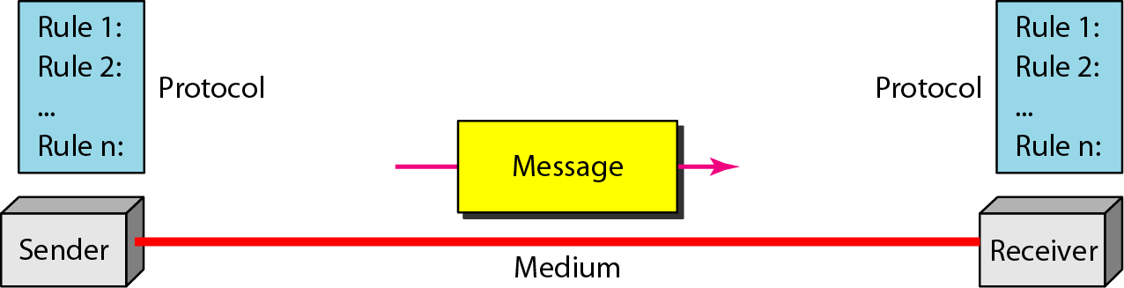
Figure 1.1 Five components of data communication
Figure 1.1 Five components of data communication [1]

Slide 5
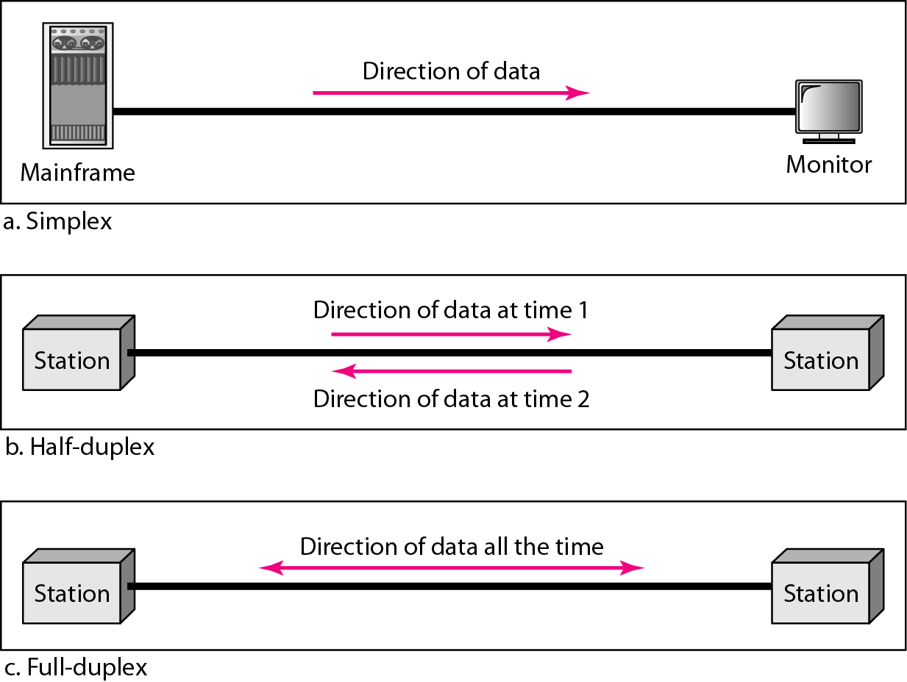
Figure 1.2 Data flow (simplex, half-duplex, and full-duplex) [1]

Slide 6
Simplex
In simplex mode, the communication is unidirectional, as on a one-way street. Only one of the two devices on a link can transmit; the other can only receive. Keyboards and traditional monitors are examples of simplex devices. The keyboard can only introduce input; the monitor can only accept output. The simplex mode can use the entire capacity of the channel to send data in one direction.
Half-Duplex
In half-duplex mode, each station can both transmit and receive, but not at the same time. When one device is sending, the other can only receive, and vice versa. The half-duplex mode is like a one-lane road with traffic allowed in both directions. When cars are traveling in one direction, cars going the other way must wait. In a half-duplex transmission, the entire capacity of a channel is taken over by whichever of
the two devices is transmitting at the time. Walkie-talkies and CB (citizens band) radios are both half-duplex systems. The half-duplex mode is used in cases where there is no need for communication in both directions at the same time; the entire capacity of the channel can be utilized for each direction.
Full-Duplex
In full-duplex mode, both stations can transmit and receive simultaneously The full-duplex mode is like a two-way street with traffic flowing in both directions at the same time. In full-duplex mode, signals going in one direction share the capacity of the link: with signals going in the other direction. This sharing can occur in
two ways: Either the link must contain two physically separate transmission paths, one for sending and the other for receiving; or the capacity of the channel is divided between signals traveling in both directions.
One common example of full-duplex communication is the telephone network. When two people are communicating by a telephone line, both can talk and listen at the same time. The full-duplex mode is used when communication in both directions is required all the time. The capacity of the channel, however, must be divided between the two directions.

Slide 7
1-2 NETWORKS
A network is a set of devices (often referred to as nodes) connected by communication links. A node can be a computer, printer, or any other device capable of sending and/or receiving data generated by other nodes on the network.
Topics discussed in this section:
Distributed Processing
Network Criteria Physical Structures Network Models Categories of Networks Interconnection of Networks: Internetwork

Slide 8
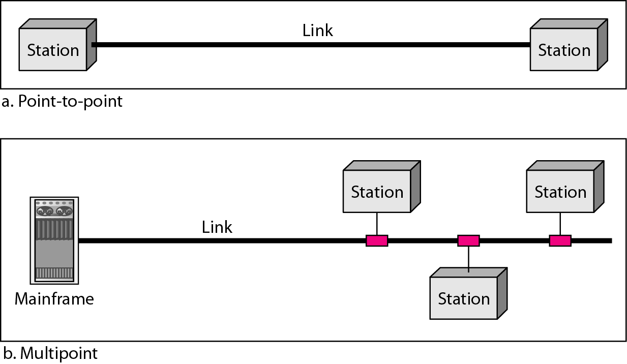
Figure 1.3 Types of connections: point-to-point and multipoint [1]

Slide 9
Types of connections: point-to-point and multipoint
Point-to-Point
A point-to-point connection provides a dedicated link between two devices. The entire capacity of the link is reserved for transmission between those two devices. Most point-to-point connections use an actual length of wire or cable to connect the two ends, but other options, such as microwave or satellite links, are also possible. When you change television channels by infrared remote control, you are establishing a point-to-point connection between the remote control and the television's control system.
Multipoint
A multipoint (also called multidrop) connection is one in which more than two specific devices share a single link.
In a multipoint environment, the capacity of the channel is shared, either spatially or temporally. If several devices can use the link simultaneously, it is a spatially shared connection. If users must take turns, it is a timeshared connection.

Slide 10
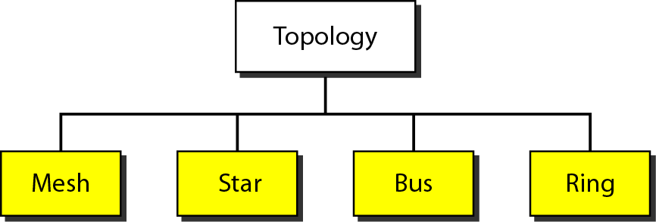
Figure 1.4 Categories of topology [1]

Slide 11
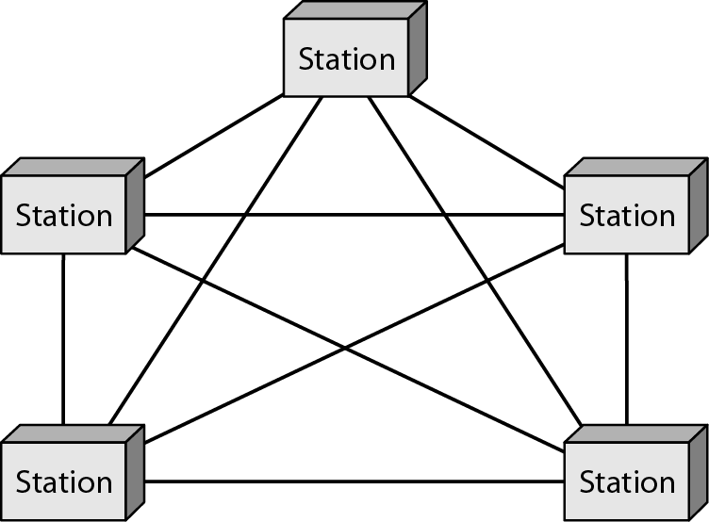
Figure 1.5 A fully connected mesh topology (five devices)
In a mesh topology, every device has a dedicated point-to-point link to every other device.
To find the number of physical links in a fully connected mesh network with n nodes, we first consider that each node must be connected to every other node. Node 1 must be connected to n - I nodes, node 2 must be connected to n – 1 nodes, and finally node n must be connected to n - 1 nodes. We need n(n - 1) physical links.
Figure 1.5 A fully connected mesh topology (five devices) [1]

Slide 12
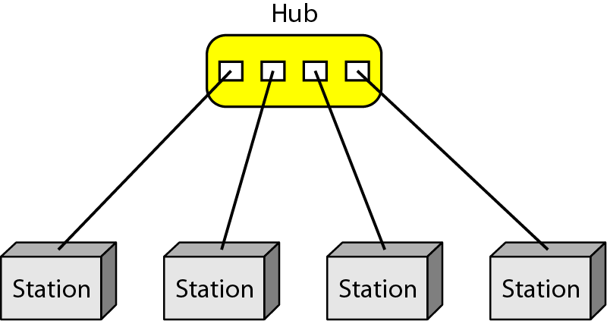
Figure 1.6 A star topology connecting four stations
In a star topology, each device has a dedicated point-to-point link only to a central controller, usually called a hub. The devices are not directly linked to one another.
A star topology is less expensive than a mesh topology. In a star, each device needs
only one link and one I/O port to connect it to any number of others. This factor also makes it easy to install and reconfigure.
Other advantages include robustness. If one link fails, only that link is affected. All other links remain active.
One big disadvantage of a star topology is the dependency of the whole topology
on one single point, the hub. If the hub goes down, the whole system is dead.
Figure 1.6 A star topology connecting four stations [1]

Slide 13
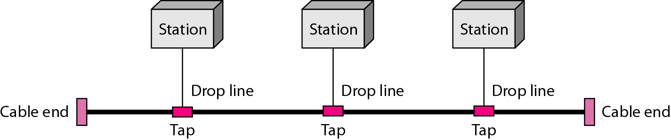
Figure 1.7 A bus topology connecting three stations [1]
Nodes are connected to the bus cable by drop lines and taps. A drop line is a connection running between the device and the main cable. A tap is a connector that either splices into the main cable or punctures the sheathing of a cable to create a contact with the metallic core.
As a signal travels along the backbone, some of its energy is transformed into heat. Therefore, it becomes weaker and weaker as it travels farther and farther. For this reason there is a limit on the number of taps a bus can support and on the distance between those taps.
Advantages of a bus topology include ease of installation.
Disadvantages include difficult reconnection and fault isolation.

Slide 14
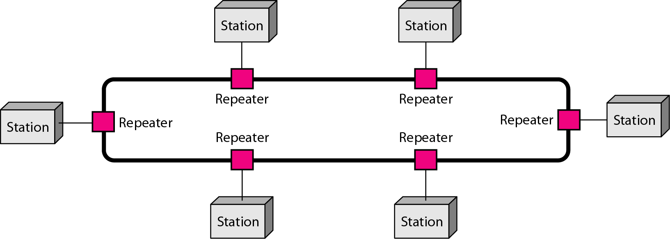
Figure 1.8 A ring topology connecting six stations [1]
In a ring topology, each device has a dedicated point-to-point connection with only the two devices on either side of it. A signal is passed along the ring in one direction, from device to device, until it reaches its destination.
A ring is relatively easy to install and reconfigure. Each device is linked to only its immediate neighbours (either physically or logically). To add or delete a device requires changing only two connections.

Slide 15
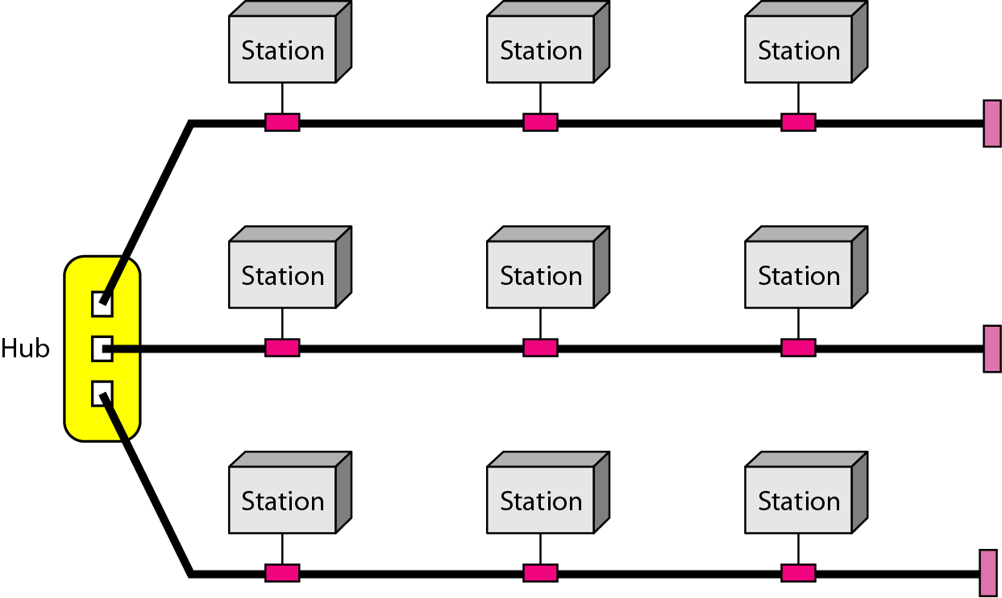
Figure 1.9 A hybrid topology: a star backbone with three bus networks [1]
A network can be hybrid. For example, we can have a main star topology with each branch connecting several stations in a bus topology.

Slide 16
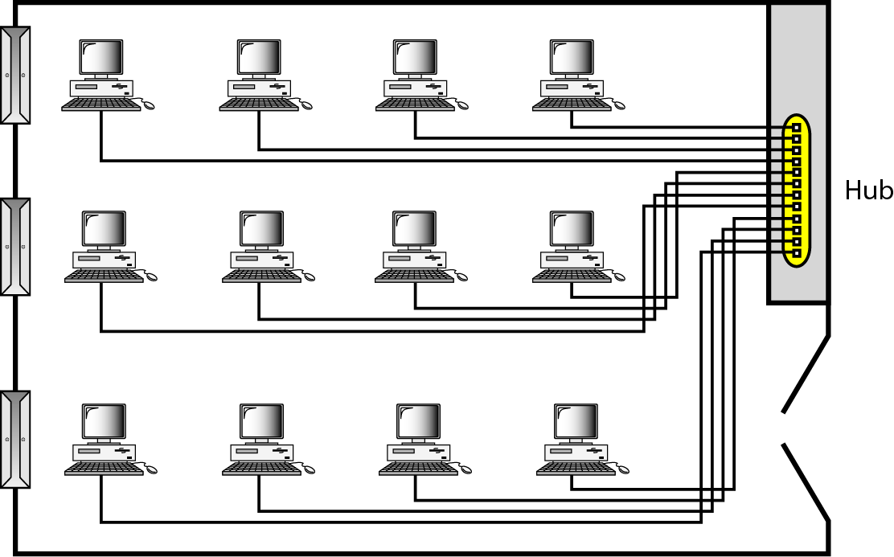
Figure 1.10 An isolated LAN connecting 12 computers to a hub in a closet[1]

Slide 17
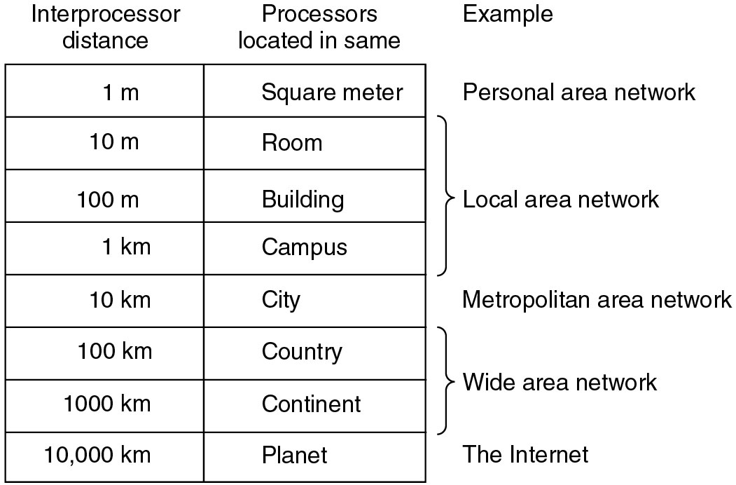
Broadcast Networks
Figure: Broadcast Networks [1]

Slide 18
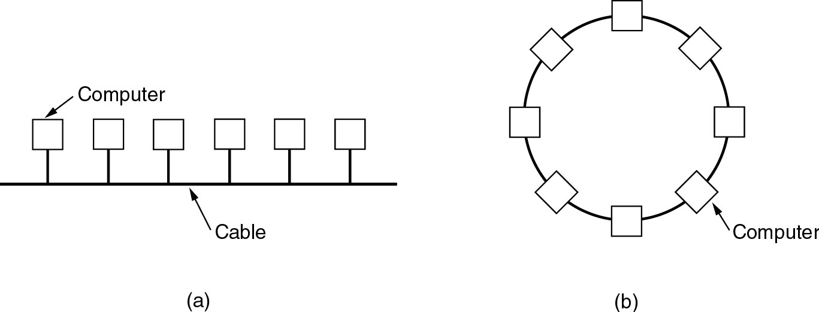
Local Area Networks
LAN (Local Area Network) [1]

Slide 19
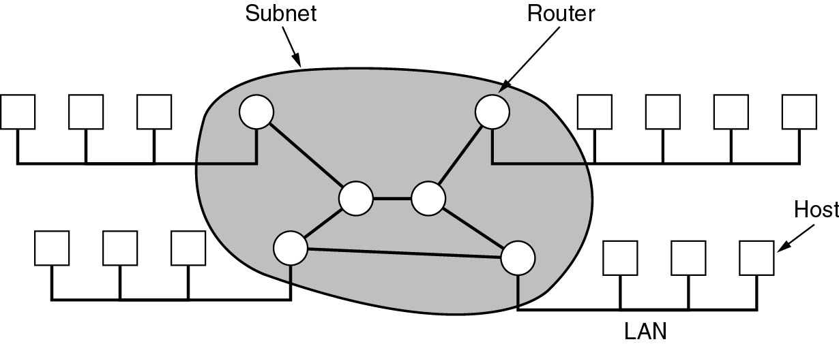
Wide Area Networks
Wide Area Network [1]
A wide area network (WAN) provides long-distance transmission of data, image, audio, and video information over large geographic areas that may comprise a country, a continent, or even the whole world.

Slide 20
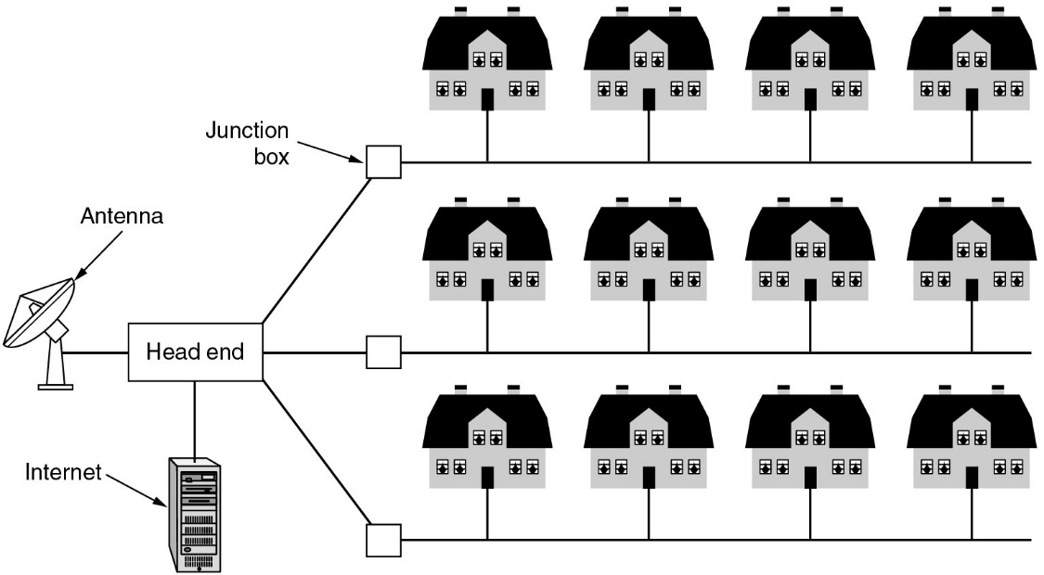
Metropolitan Area Networks
metropolitan area network (MAN)
Metropolitan Area Network [1]
A metropolitan area network (MAN) is a network with a size between a LAN and a WAN. It normally covers the area inside a town or a city. It is designed for customers who need a high-speed connectivity, normally to the Internet, and have endpoints
spread over a city or part of city. A good example of a MAN is the part of the telephone company network that can provide a high-speed DSL line to the customer. Another example is the cable TV network that originally was designed for cable TV, but today can also be used for high-speed data connection to the Internet.

Slide 21
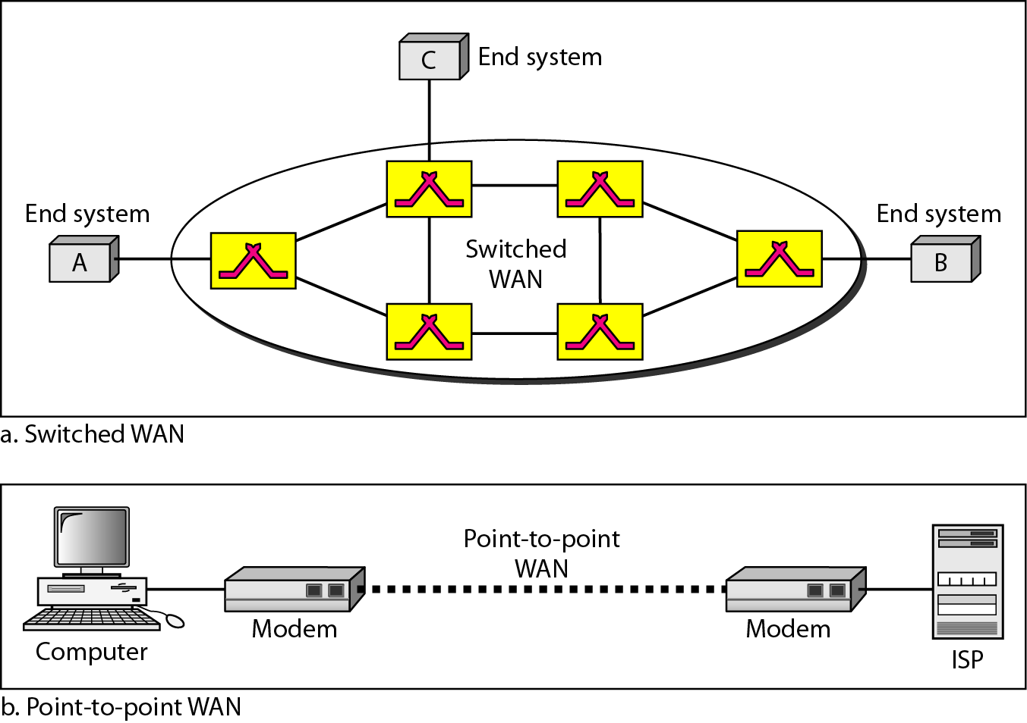
Figure 1.11 WANs: a switched WAN and a point-to-point WAN [1]

Slide 22
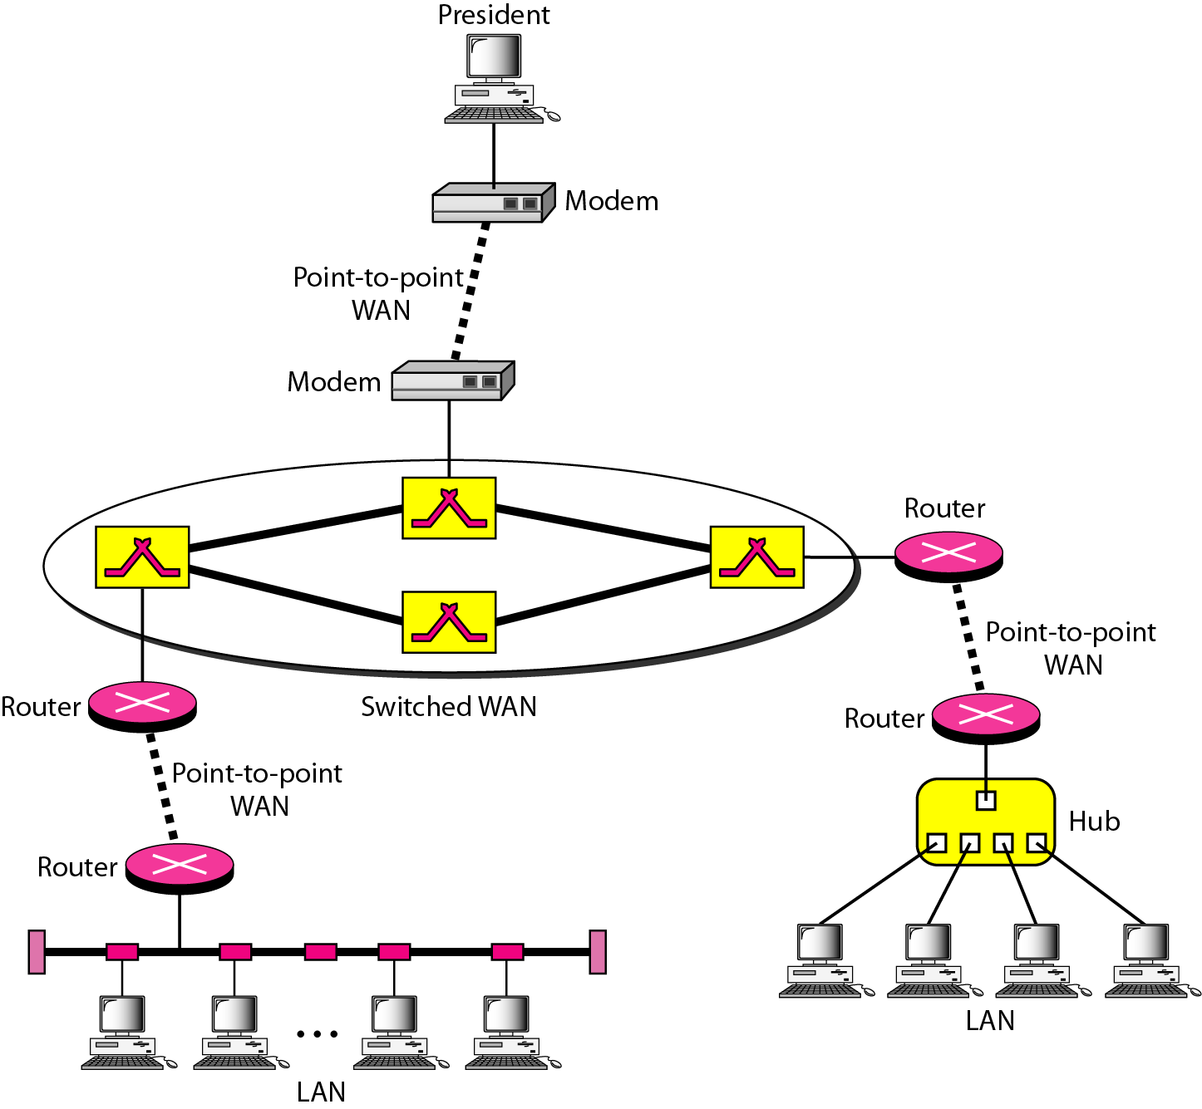
Figure 1.12 A heterogeneous network made of four WANs and two LANs [1]

Slide 23
1-3 THE INTERNET
The Internet has revolutionized many aspects of our daily lives. It has affected the way we do business as well as the way we spend our leisure time. The Internet is a communication system that has brought a wealth of information to our fingertips and organized it for our use.
Topics discussed in this section:
A Brief History
The Internet Today (ISPs)

Slide 24
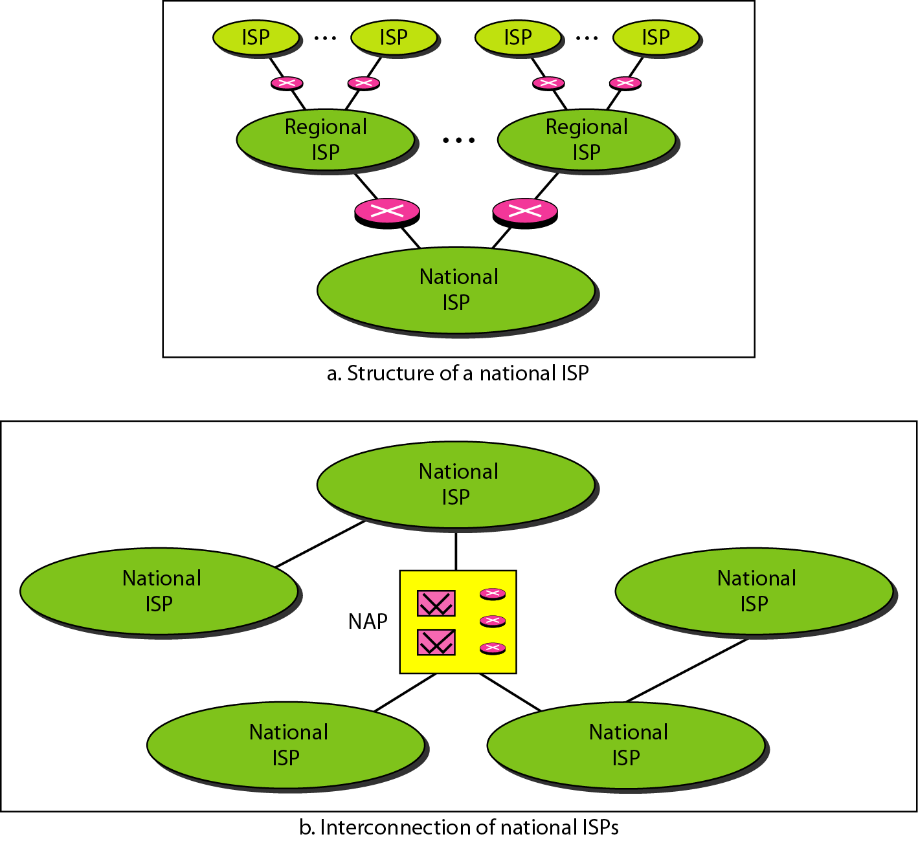
Figure 1.13 Hierarchical organization of the Internet [1]

Slide 25
1-4 PROTOCOLS AND STANDARDS
In this section, we define two widely used terms: protocols and standards. First, we define protocol, which is synonymous with rule. Then we discuss standards, which are agreed-upon rules.
Topics discussed in this section:
Protocols Standards
Standards Organizations Internet Standards

Slide 26
Protocols
A protocol is a set of rules that govern data communications. A protocol defines what is communicated, how it is communicated, and when it is communicated. The key elements of a protocol are syntax, semantics, and timing.
Syntax. The term syntax refers to the structure or format of the data, meaning the order in which they are presented. For example, a simple protocol might expect the first 8 bits of data to be the address of the sender, the second 8 bits to be the address of the receiver, and the rest of the stream to be the message itself.
Semantics. The word semantics refers to the meaning of each section of bits. How is a particular pattern to be interpreted, and what action is to be taken based on that interpretation? For example, does an address identify the route to be taken or the final destination of the message?
Timing. The term timing refers to two characteristics: when data should be sent and how fast they can be sent. For example, if a sender produces data at 100 Mbps but the receiver can process data at only 1 Mbps, the transmission will overload the receiver and some data will be lost.

Slide 27
Standards
Standards are essential in creating and maintaining an open and competitive market for equipment manufacturers and in guaranteeing national and international interoperability of data and telecommunications technology and processes. Standards provide guidelines
to manufacturers, vendors, government agencies, and other service providers to ensure the kind of interconnectivity necessary in today's marketplace and in international communications. Data communication standards fall into two categories: de facto (meaning "by fact" or "by convention") and de jure (meaning "by law" or "by regulation").
Standards Organizations
Standards are developed through the cooperation of standards creation committees, forums, and government regulatory agencies.
International Organization for Standardization (ISO).
International Telecommunication Union-Telecommunication Standards Sector (ITU-T).
American National Standards Institute (ANSI)
Institute of Electrical and Electronics Engineers (IEEE).
Electronic Industries Association (EIA).

Slide 28
References:
Textbooks
[1]Forouzan, Behrouz A.: “Data Communications & networking”, 4th edition TataMcgraw Hill.
[2] Tanenbaum, Andrew S: “Computer networks”, 4th Edition, Pearson education.
Reference books
[3] Stallings, William : “Data and computer communications”,8th edition,Pearson
Education.
[4] Ross, Kurose,“Computer Networking: A top down Approach”, 2nd edition, Pearson
Education.
[5] Coomer,Douglas E.: “Internet working with TCP/IP” , 2 nd edition, Pearson Education
[6] Dave,” Computer Networks, Cengage Learning.
Links:
http://eti2506.elimu.net/Introduction/Books/Data%20Communications%20and%20Networking%20By%20Behrouz%20A.Forouzan.pdf

